Slide 1


TestShield
Fake TC Prevention Solution
Notes:
Change logo

Slide 2
Agenda
1
2
3
As – is Process
Shortcomings of As – Is Process
Problems addressed by blockchain
Current process: Distributor orders, manufacturer delivers goods with Test Certificate
Inefficiencies and errors caused by current process.
Ensures secure, traceable, and tamper-proof transfer of certificates.
4
5
6
Digital TC Process
View Digital TC
TC Verification from platform
Automated TC issuance: seamless digital process from manufacturer to distributor to end – customers.
Process and access digital Test Certificates (TC) efficiently.
Streamlined TC verification process through our platform.
Notes:
Change logo

Slide 3
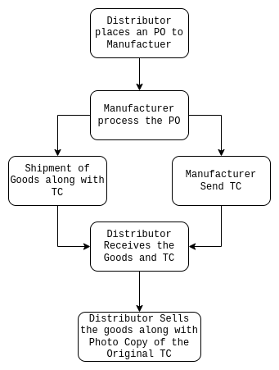
As-Is Process
Distributor places a purchase order to the manufacturer
Manufacturer processes the order
Manufacturer sends the Goods and Physical copy of the TC to the Distributor
Distributor sells the goods along with a PhotoStated copy of the Original TC
3

Slide 4
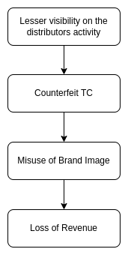
Shortcomings of As-Is Process
There is no visibility after the shipment of the goods
Chances to use the brand image along with using Counterfeit TC and Goods
Erosion of brand reputation
Revenue loss due to misuse of brand image and fulfilling the demand with fake products
Notes:
Process of issue occurrence

Slide 5
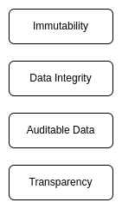
Problems addressed by blockchain
Core Features of Blockchain
Digitise issued TC
Digital Sign & QR code
Digitization of TC Issuance makes it more faster and reliable
Digital signatures on TCs can be used to validate the authenticity of the TC and invalidating physical copy of the TC
Transparency
Data Integrity
Transactions of a TC need to be transparent to the Customers and Consumers
TC data needs to be tamper proof to maintain the reliability, trustworthiness and the brand image

Slide 6
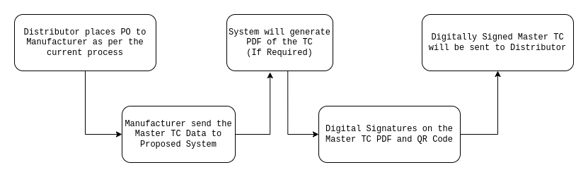
Digital TC Process – Manufacturer to Distributor
Test Certificates (TC) will be generated through the Oracle system as mandated by MSL.
Digitize TC Issuance
Digitization of TC Issuance makes it more faster and reliable
Digital signatures on TCs can be used to validate the authenticity of the TC and invalidating physical copy of the TC
* Digitally signed Test Certificates can be viewed from the platform
* Digitally signed Test Certificates can be sent over email

Slide 7
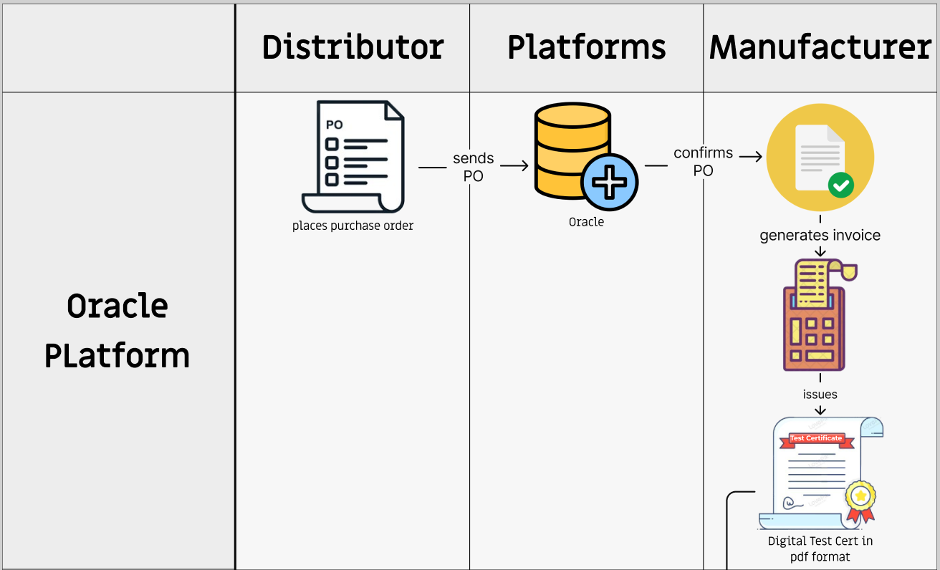
Digital TC Process – Manufacturer to Distributor

Slide 8
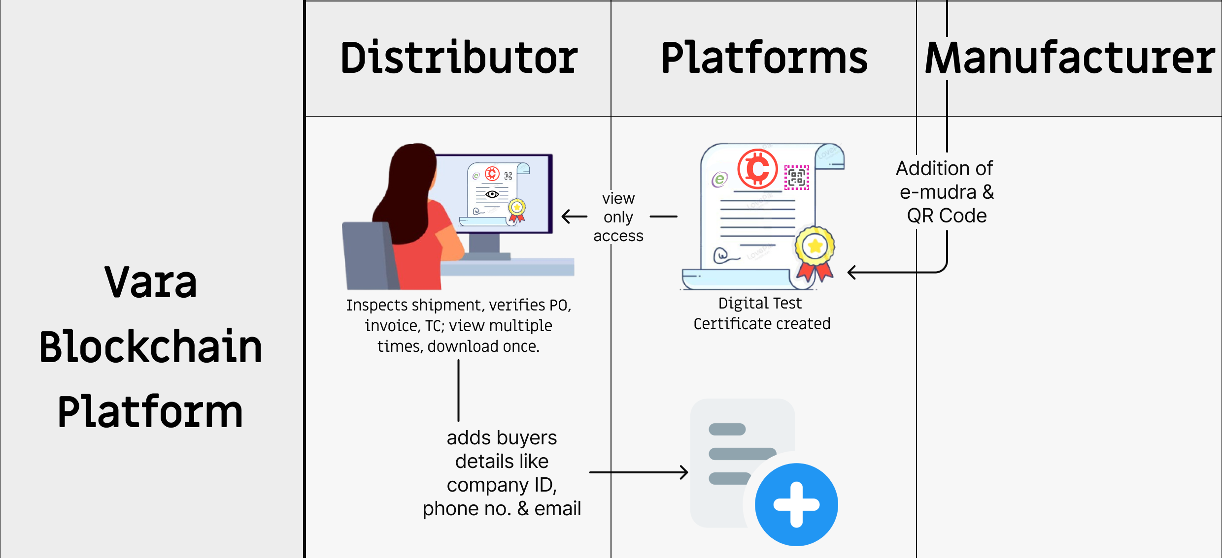
Digital TC Process – Manufacturer to Distributor

Slide 9
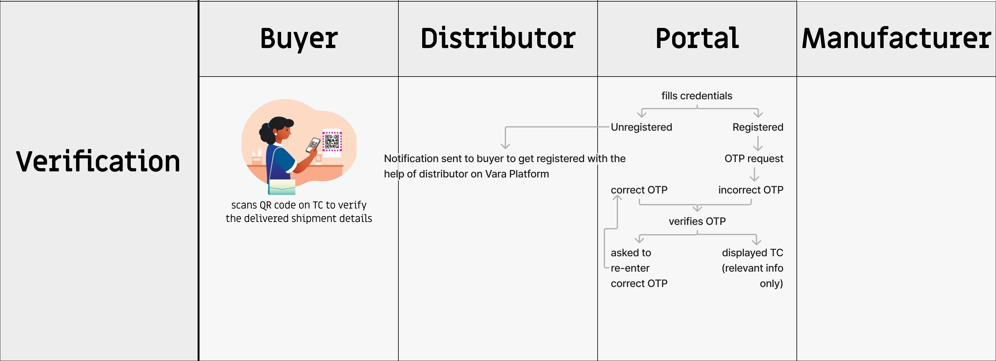
Digital TC Process – Buyer Verifies

Slide 10
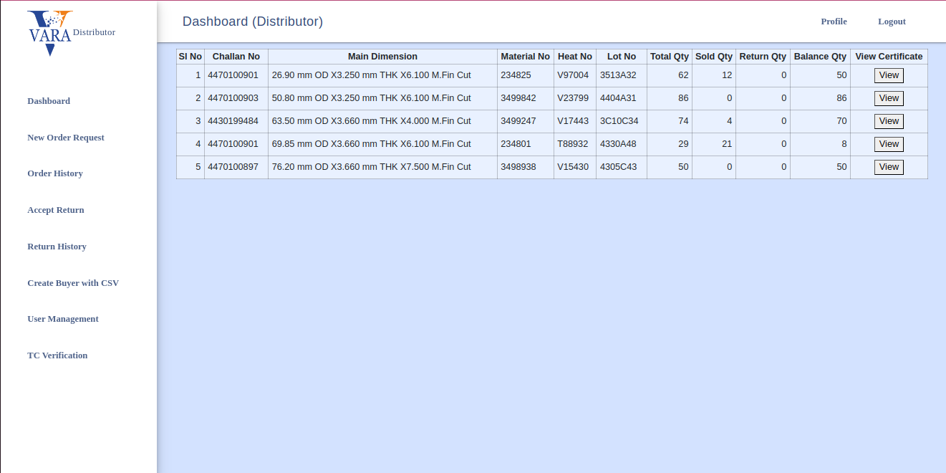
View Digital TC - Step 1
Digitize TC Issuance
Digital Signature
Digitization of TC Issuance makes it more faster and reliable
Digital signatures on TCs can be used to validate the authenticity of the TC and invalidating physical copy of the TC

Slide 11
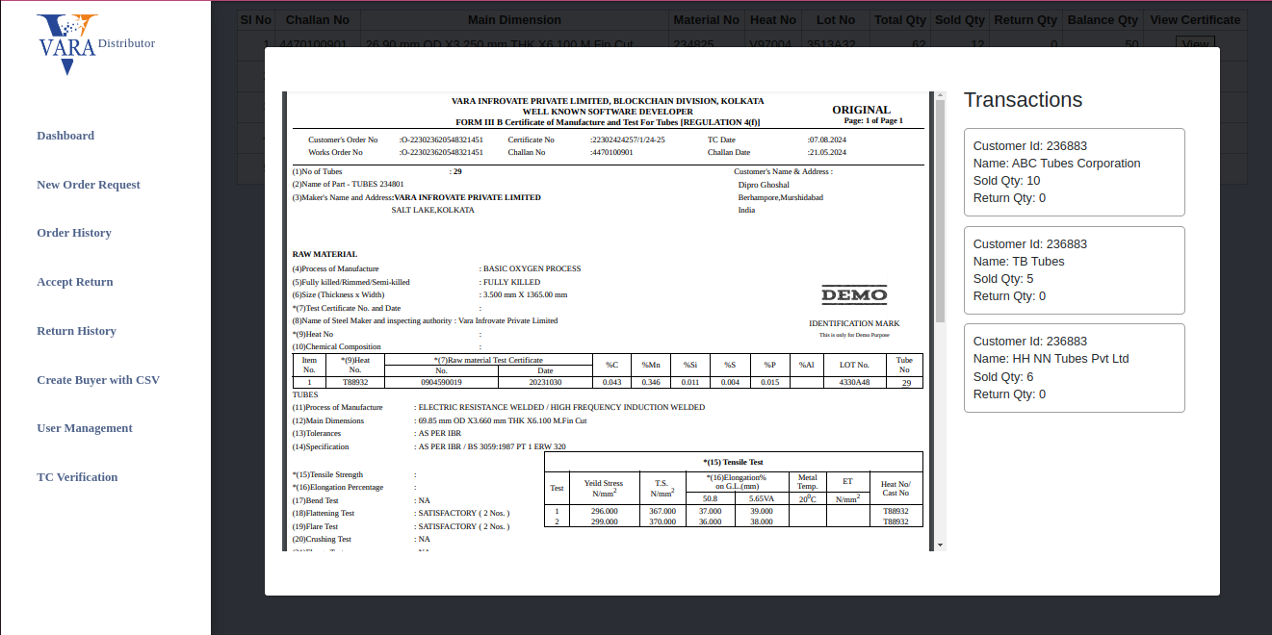
View Digital TC - Step 2
Digitize TC Issuance
Digital Signature
Digitization of TC Issuance makes it more faster and reliable
Digital signatures on TCs can be used to validate the authenticity of the TC and invalidating physical copy of the TC

Slide 12
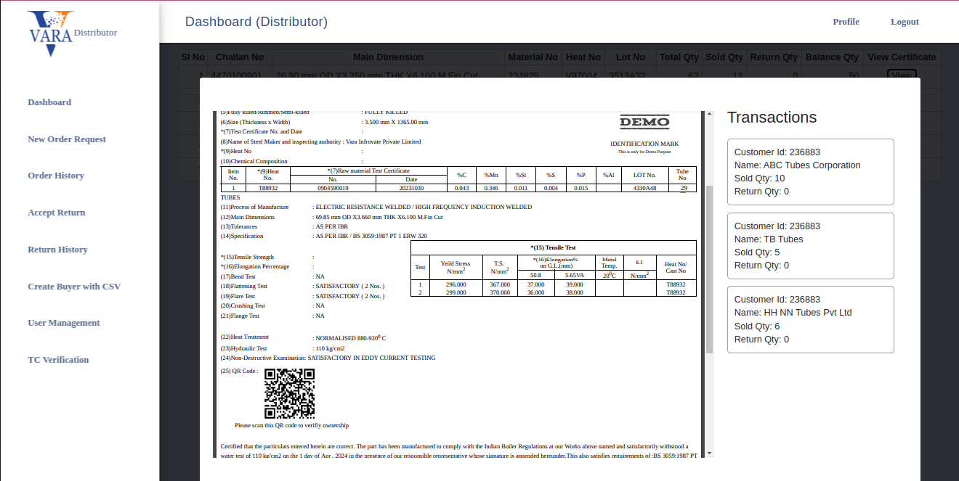
View Digital TC - Step 2 - After scrolling down
Digitize TC Issuance
Digital Signature
Digitization of TC Issuance makes it more faster and reliable
Digital signatures on TCs can be used to validate the authenticity of the TC and invalidating physical copy of the TC

Slide 13
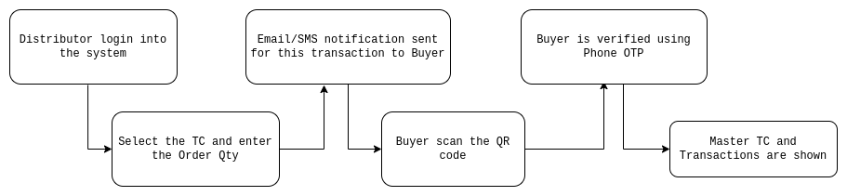
Digital TC Process – Distributor to end customer
Digitize TC Issuance
Digital Signature
Digitization of TC Issuance makes it more faster and reliable
Digital signatures on TCs can be used to validate the authenticity of the TC and invalidating physical copy of the TC
1. Distributor (Seller) logs a transaction of gods quantity into the platform
2. Buyer gets notification over Email/SMS
3. Buyer scans the QR Code
Seller can provide the printout of the original TC which has the QR code
Ownership of the TC is not proven without the platform confirmation
4. Buyer authenticate to view the TC
5. View the TC and Transactions

Slide 14
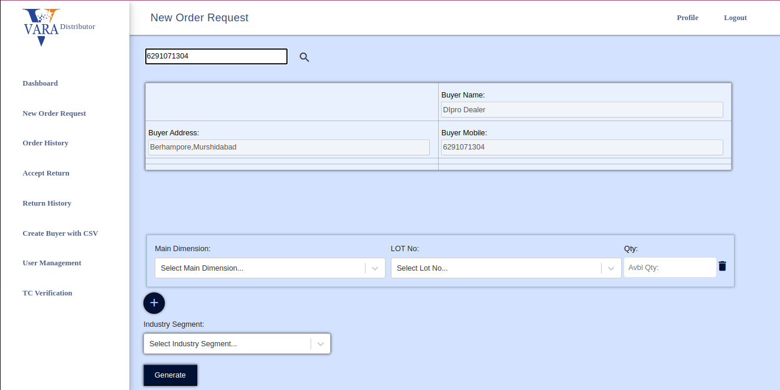
TC Verification from Platform - Step 1
Enter the buyer details
Digitize TC Issuance
Digital Signature
Digitization of TC Issuance makes it more faster and reliable
Digital signatures on TCs can be used to validate the authenticity of the TC and invalidating physical copy of the TC

Slide 15
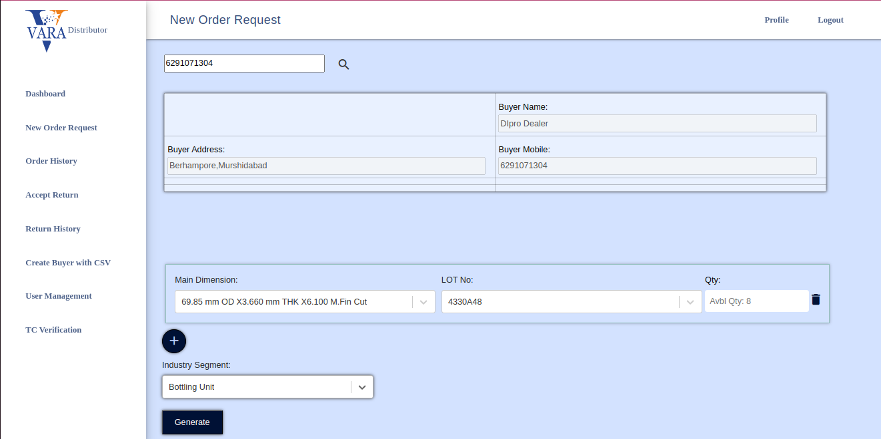
TC Verification from Platform - Step 2
Enter the product details
Digitize TC Issuance
Digital Signature
Digitization of TC Issuance makes it more faster and reliable
Digital signatures on TCs can be used to validate the authenticity of the TC and invalidating physical copy of the TC

Slide 16
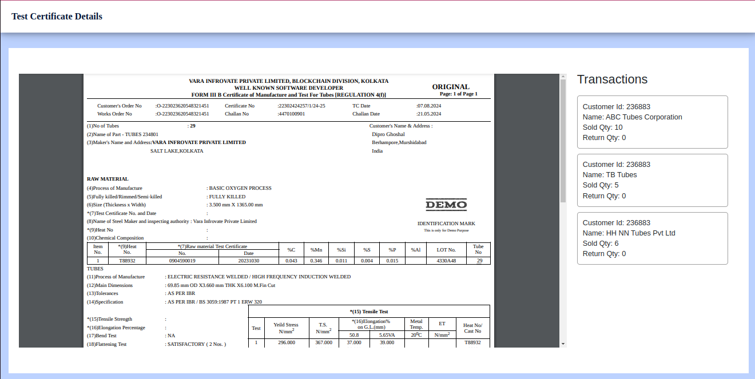
TC Verification from Platform - Step 2
View the TC and Transactions after OTP Authentication
Digitize TC Issuance
Digital Signature
Digitization of TC Issuance makes it more faster and reliable
Digital signatures on TCs can be used to validate the authenticity of the TC and invalidating physical copy of the TC

Slide 17

THANK YOU
MUMBAI | GURUGRAM | KOLKATA
Follow us
www.varatechnology.com

Slide 18
Annexure

Slide 19
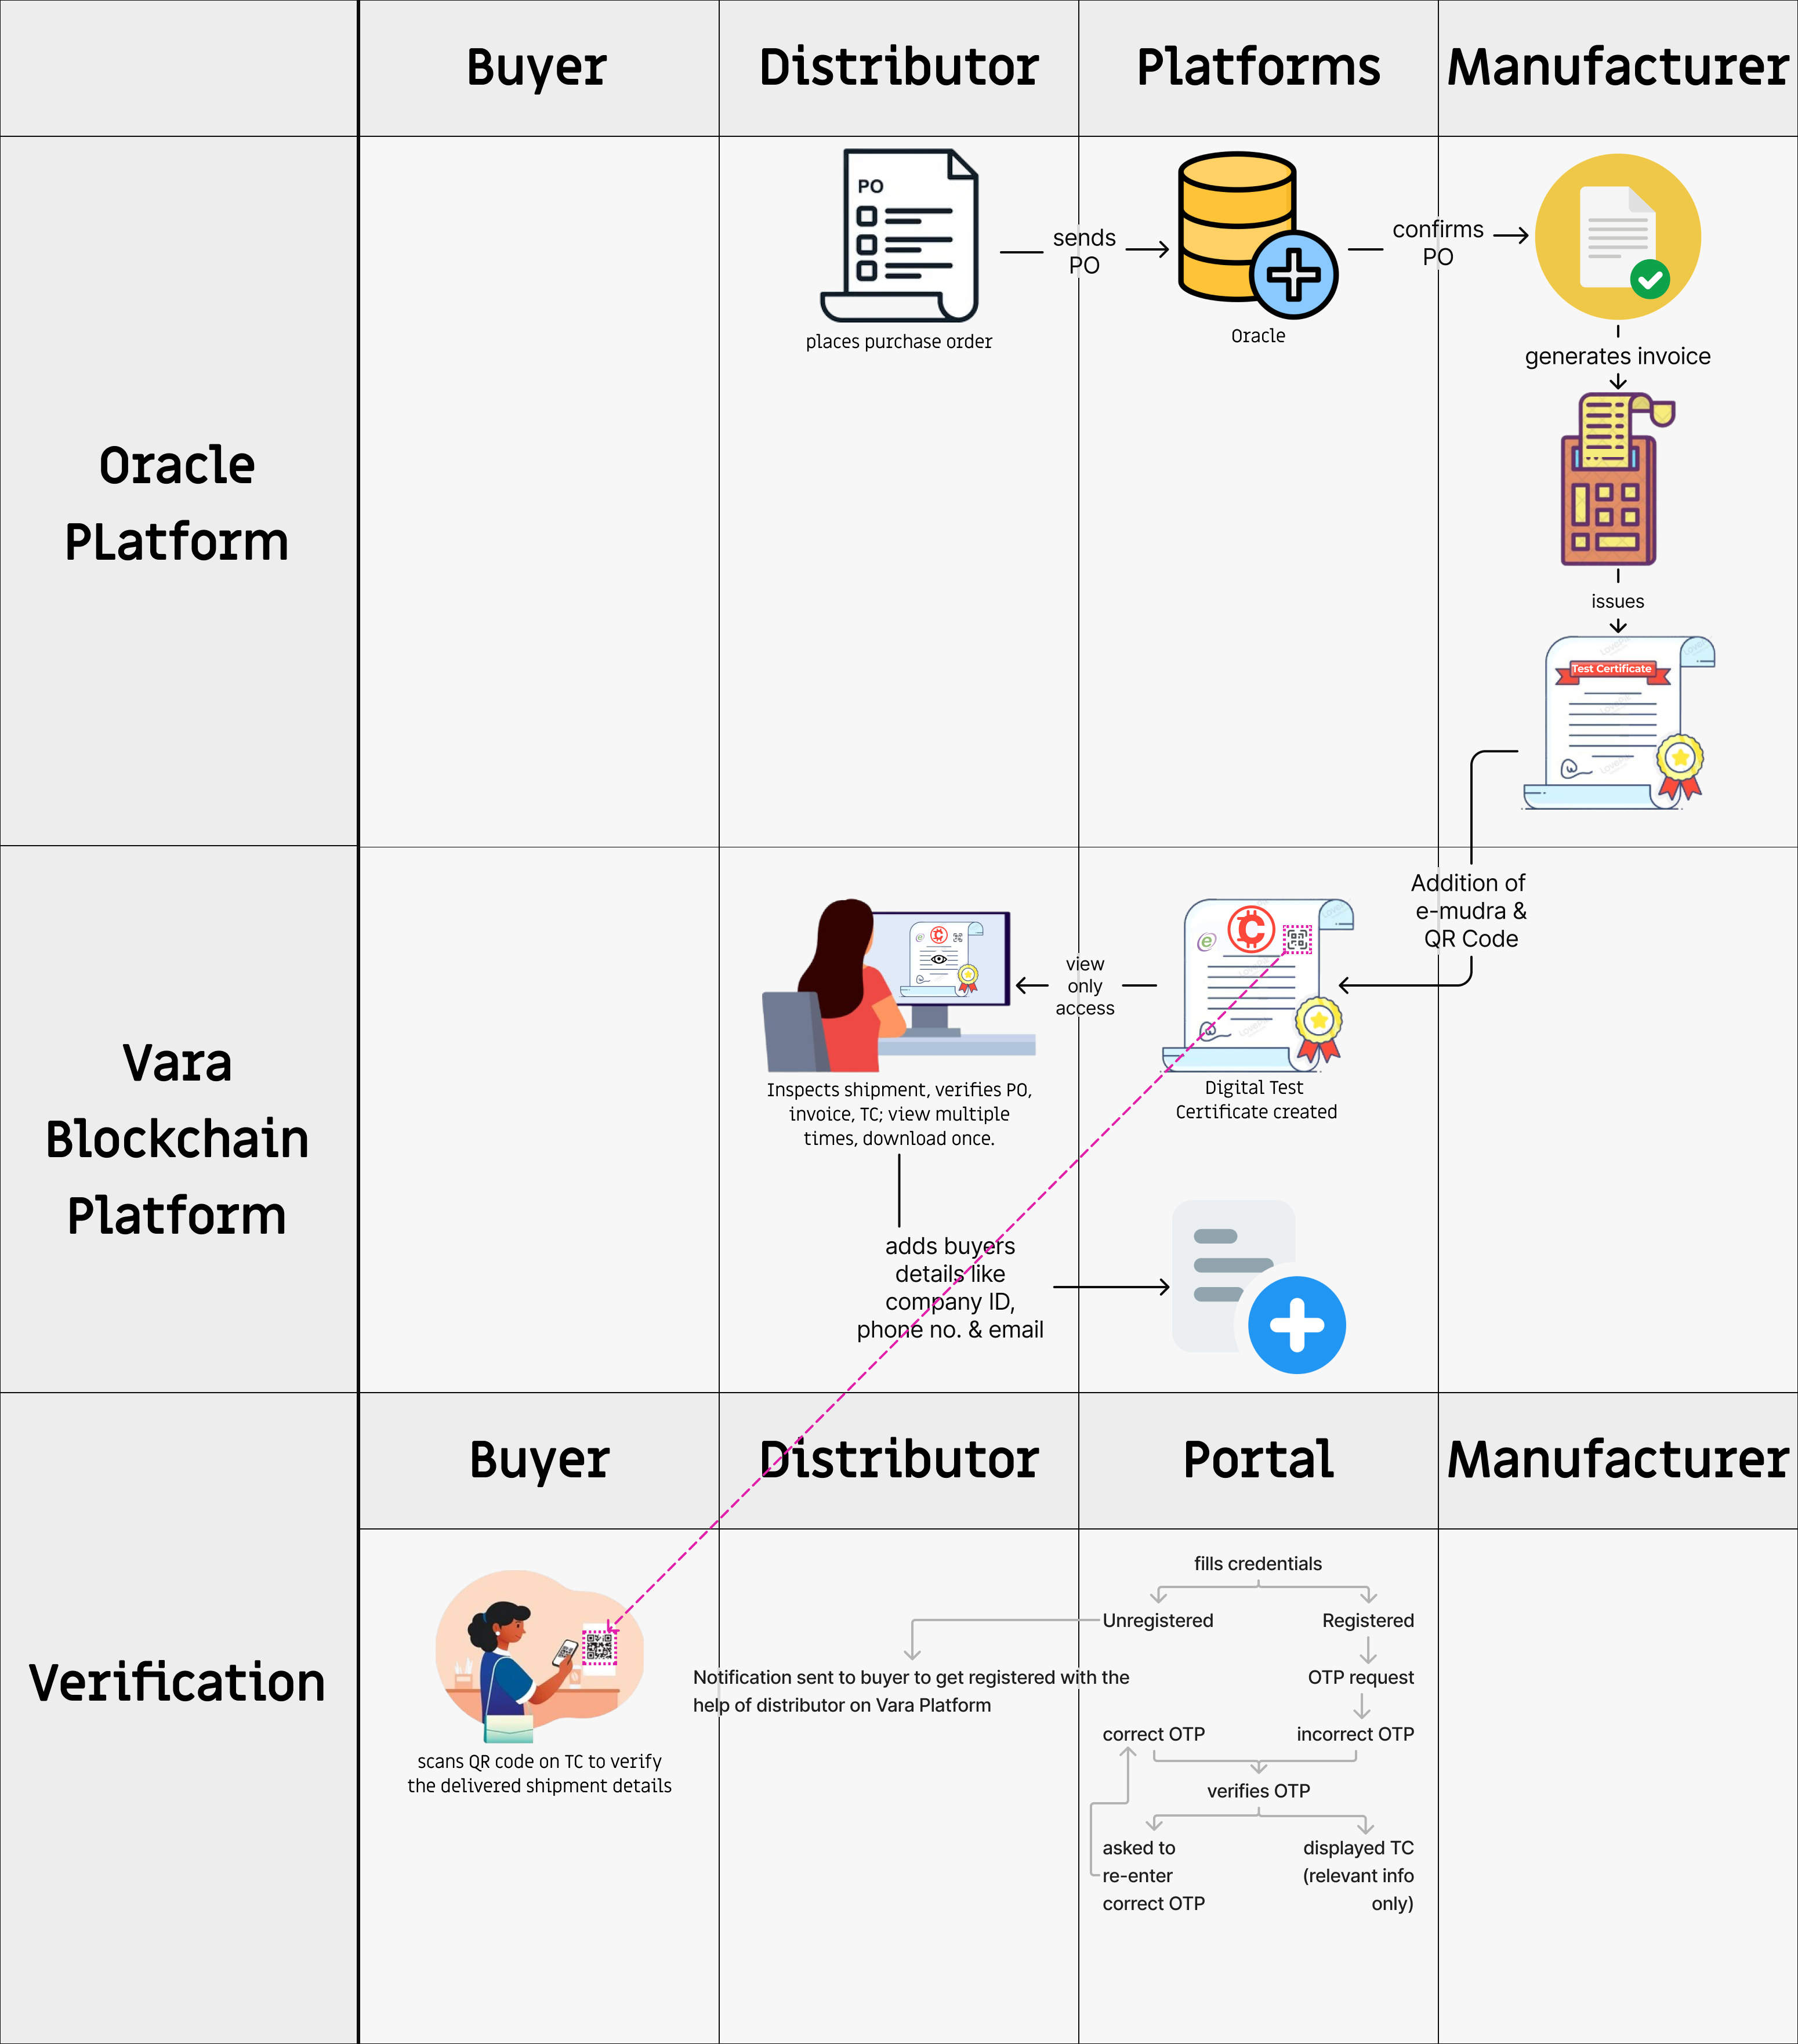
Digital TC Process Overall Flow

